Slide 1


COS711 Assignment 3
Zingisa Matwana: u25719302

Slide 2
Data Preparation
Discuss all data preparation steps taken
Bullets
Bullets
Bullets
Bullets
Bullets

Slide 3







Residual Networks Model
ResNet: Residual learning block
ResNet (Residual Network) — a deep convolutional neural network introduced by He et al., 2015
Designed to solve the vanishing gradient problem in very deep networks
Uses residual (skip) connections that allow gradients to flow directly through layers
Enables training of very deep models (50+ layers) without performance degradation
ResNet-50 specifically has:
  49 convolutional layers + 1 fully connected output layer
  ~25 million parameters
  Pretrained on ImageNet (1.2M natural images, 1000 classes)
  Acts as a universal feature extractor — lower layers capture edges/textures, upper layers adapt to task-specific shapes
$$x$$
weight layer
$$x$$
$$F_{\left(x\right)}$$
$$relu$$
$$identity$$
weight layer
$$F_{\left(x\right)}+x$$
$$relu$$
K. He, X. Zhang, S. Ren, and J. Sun, “Deep Residual Learning for Image Recognition,” in Proceedings of the IEEE Conference on Computer Vision and Pattern Recognition (CVPR), Las Vegas, NV, USA, 2016, pp. 770–778. [Online]. Available: https://arxiv.org/pdf/1512.03385

Slide 4
Fine-Tuning ResNet-50 for Radio Galaxy Morphology Classification
Base Model: Pretrained ResNet-50 with ImageNet weights
Objective: Classify MeerKAT radio galaxy images into 9 morphology classes
Classes: FR I, FR II, Bent, Point Source, Typical, S/Z-shaped, X-shaped, Exotic, and Discarded
Data Split: 80% training / 20% validation (stratified by class)
Training Setup:
  Batch = 32, Learning Rate = 1 x 10⁻⁴, Epochs = 25
  Early stopping enabled
  Training executed on CPU (no GPU acceleration)
Fine-Tuning Strategy:
  Lower convolutional layers frozen to retain general visual features
  Upper layers unfrozen and optimized for domain-specific radio morphology patterns

Slide 5
Model Training and Convergence
Training loss steadily decreased from 2.14 to 1.29 across 19 epochs
Validation loss stabilised around 1.9, indicating controlled generalisation
Best checkpoint saved at Epoch 13
  Macro-F1 = 0.3112, Accuracy = 0.44
  Early stopping triggered after 6 epochs with no further F1 gain
Key Performing Classes:
  Point Source (F1 ≈ 0.66) - distinct compact intensity regions
  FR II (F1 ≈ 0.49) - well-defined double-lobe morphology
  FR I (F1 ≈ 0.39) - moderate separability from background
Minority classes (X-shaped, S/Z-shaped, Exotic) remained under-represented and difficult to classify

Slide 6
Results: Classification
How well did your classifier do on the various classes? Were some classes handled better than others?
Bullets
Bullets
Bullets
Bullets

Slide 7
Results: Classification Enhancement
How did pseudo-labelling and other methods applied affect the labelling?
Bullets
Bullets
Bullets
Bullets
Bullets

Slide 8
Qualitative Analysis:
Automatically Labelled Sample
Show a sample of previously unlabelled images together with the labels assigned by your model, and discuss if the labels seem viable.

Slide 9
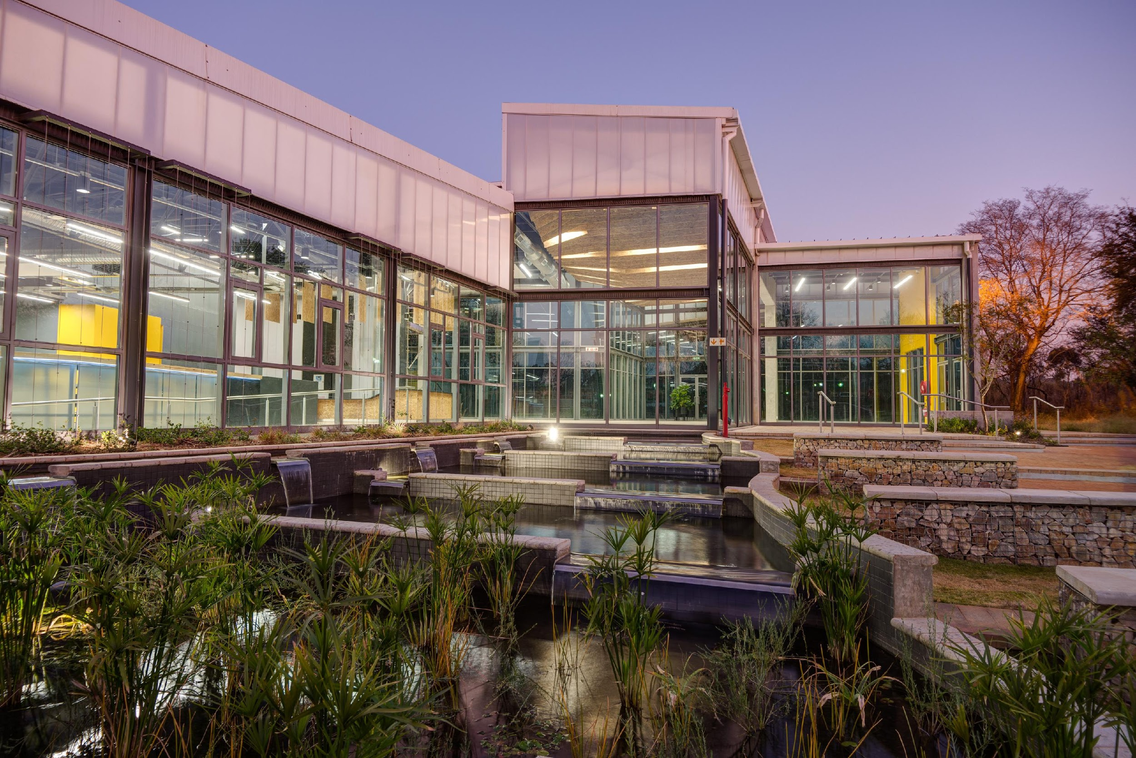
Conclusions
Very general conclusions about the assignment that you have done.
This section ``answers'' the questions and issues that you have raised and investigated.
This section is, in general, a summary of what you have done, what the results were, and finally what you concluded from these results

Slide 10
Bibliography
Paper 1
Paper 2
Website 3

